Slide 1

GRADUATE DIPLOMA OF LEARNING AND TEACHING
KAIAKO HÅPAI - ASSOCIATE TEACHERS HUI
Nau mai, haere mai, Kaihāpai-a-Kura (mentor teachers) & kaiako hāpai (associate teachers)
Ngā mihi nui for sharing your valuable time
with us today - it is much appreciated.
Please add a brief introduction to the chat

Slide 2
OPENING KARAKIA
Tuia ki runga
Tuia ki raro
Tuia ki roto
Tuia ki waho
Tuia te here tangata
Tūturu o whiti
Whakamaua kia tina
Tina! Haumi e, hui e, TĀIKI E!

Slide 3
SESSION OUTLINE
Core team members
Programme Structure
Professional Practice Courses
  Kaihāpai-a-Kura Collaboration
  Practicum Timings
  Tasks
  Collaboration with AT’s
Pātai

Slide 4
SESSION OUTCOME
By the end of this session, my hope is you have greater clarity around:
Massey ITE Primary’s practicum tasks and requirements
How AT’s can best support Massey student teachers (Kaiako pitomata) while on practicum
Pātai you might have about practicum specifically
Navigation of the practicum handbook
He Ara Ngaio He Ara Ako – website

Slide 5
Pātai?
Pop your questions about Professional Practice in the chat as we go.
I’ll endeavour to answer them as we move along and address any not answered at the end.
As today’s focus is Professional Practice, should other questions arise, I’ll do my best to either answer them today or take them back to our programme leads. I will then share responses via a follow up email

Slide 6
NGĀ MIHI NUI
We truly appreciate the partnership and collaboration with Schools.
We understand the need to work together to support kaiako pitomata to move to the PCT Mentoring Programme, and ultimately, join us all as colleagues in our kura.
We are here to support you as much as our Kaiako Pitomata. Please reach out when we can be of assistance.

Slide 7
OUR CORE TEAM
Programme Leads
Judith Donaldson J.Donaldson@massey.ac.nz
Endorsement Lead – Primary
Maria Dacre M.Dacre@massey.ac.nz
Clinical Educator/Practicum Coordinator - Primary
Jasmine Hansen J.Hansen1@massey.ac.nz
Practicum Administrator:
Janene Davidson PrimaryPlacements@massey.ac.nz
Primary Core Staff
Louise Fitzgerald Jared Carpendale Danielle Hodson
Raewyn Eden Philippa Isom Melinda Dixon

Slide 8
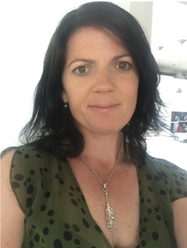
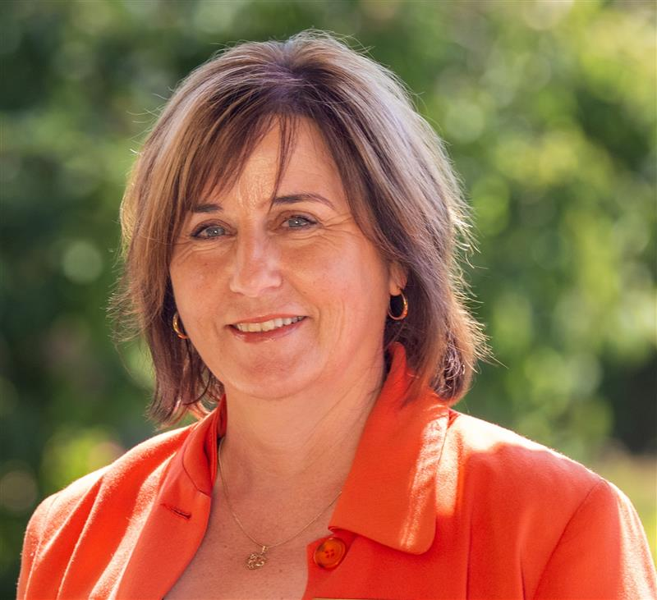
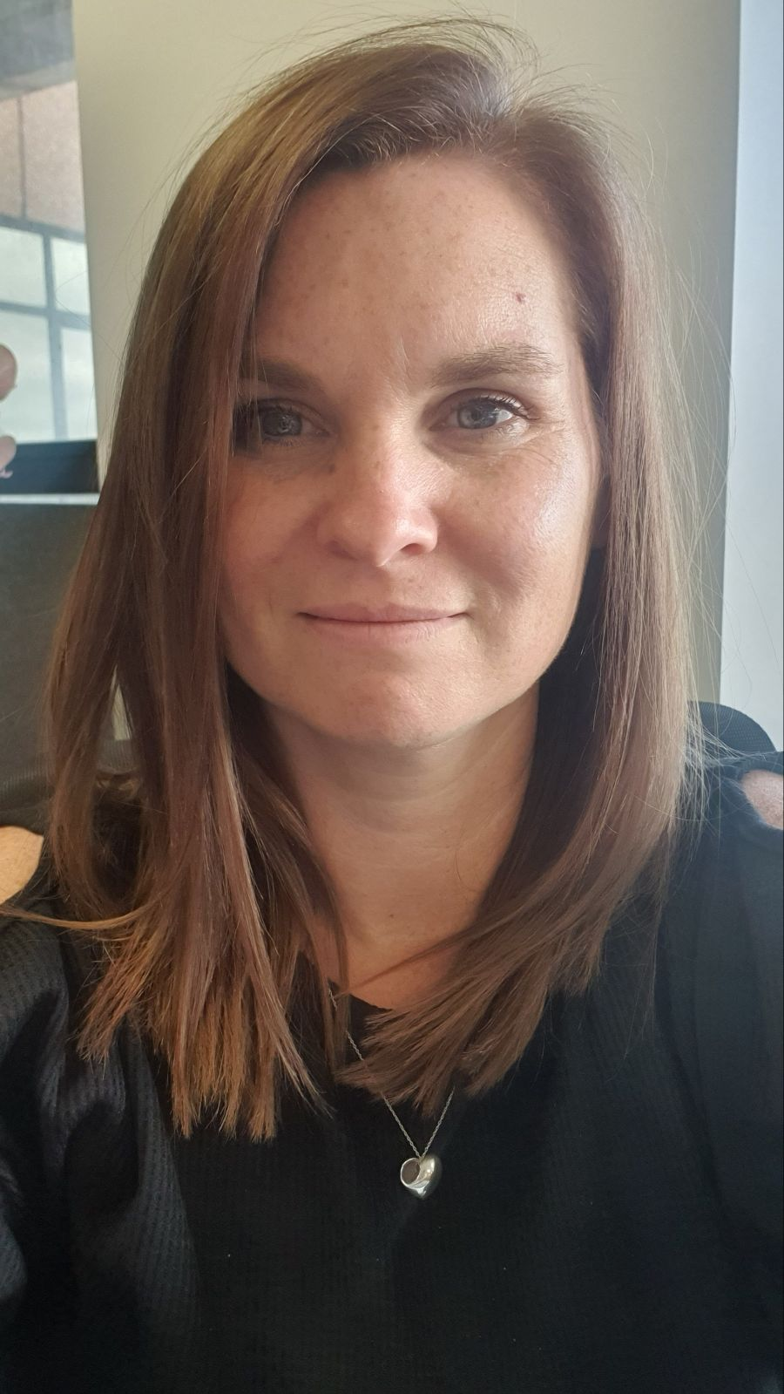
KEY CONTACTS FOR PRIMARY PRACTICUM
Jasmine Hansen - contact Jasmine for all student-related queries and concerns
TITLE: | Course Coordinator/Clinical Educator – Primary Endorsement
CONTACT DETAILS: | Email: J.Hansen1@massey.ac.nz Phone: 06 356 9099 extn 84472 Mobile: 021536057
Janene Davidson – contact Janene for administration queries
TITLE: | Senior Administrator – Primary Practicum and Selection
CONTACT DETAILS: | Email: PrimaryPlacements@massey.ac.nz Phone: 06 356 9099 extn 84472
Melissa Chanyi– contact Melissa for any practicum payroll queries
TITLE: | Senior Administrator - Finance and Practicum
CONTACT DETAILS: | Email: M.Chanyi@massey.ac.nz Phone: 06 356 9099 extn 84505

Slide 9
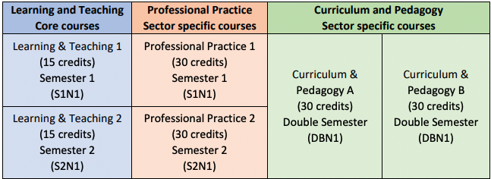
PROGRAMME STRUCTURE
There are three strands, each containing two courses
Full-time students take six courses
Part-time students take one course from each strand each year
Our programme is offered as either Internal or Distance

Slide 10
OUR TOHU AND TŪĀPAPA
He waka eke noa, he whānau aroha noa, he kaupapa puta noa
At the heart of this programme is the right for all to flourish. Te Tiriti o Waitangi is the waka that carries us on our learning and teaching journey. This programme reflects the dynamic, complex and responsive nature of learning and teaching and fosters connectedness, courage, curiosity and creativity. Graduates will have an emergent sense of identity and efficacy to respond with care and aroha in all their interactions.

Slide 11
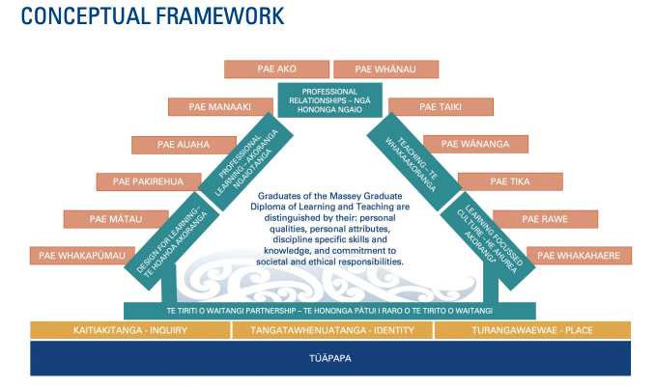
TŪĀPAPA
Notes:
The conceptual framework for the programme is grounded on the tūāpapa. Rising from the tūāpapa is the paepae which embodies three core principles that are woven throughout the programme: Kaitiakitanga, Inquiry; Tangatawhenuatanga, Identity; Tūrangawaewae, Place. The paepae connects the Standards for the Teaching Profession to the tūāpapa, through the metaphor of a centrally situated wharenui. The wharenui rests within the shelter of Paerangi, the Massey University Teaching and Learning Strategy. It creates the meeting place where students learn and grow through partnership; a place where ideas, learning and authentic experiences are woven together, enabling Massey graduates to confidently embody the Graduate Profile, The Code of Professional Responsibility, and the Standards for the Teaching Profession.

Slide 12
PROFESSIONAL PRACTICE COURSES (PP)
A total of 16 weeks of practicum placements
Weekly sessions with the Clinical Educator
Regular sessions with their Massey Mentor (Kaihāpai)
There are two professional practice courses:
  Professional Practice 1
    Includes practicum 1A and 1B
  Professional Practice 2
    Includes practicum 2

Slide 13
KAIHĀPAI - Mentor
The kaihāpai is a vital mentoring and support role. At the beginning of the year, all kaiako pitomata are placed in a regional mentor group and a kaihāpai assigned.
The Kaihāpai’s role is to:
facilitate regular Zoom and/or face-to-face meetings/check-ins with the group
provide individual pastoral care and mentoring
support successful completion of the professional practice assignments
visit their kaihāpai rōpū for at least one practicum where possible
grade Professional Practice assignments of their rōpū where possible
Me he toka tū moana: Your strength is like a rock in the ocean.

Slide 14
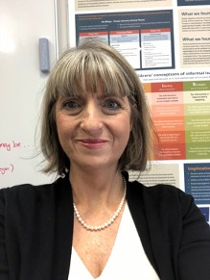
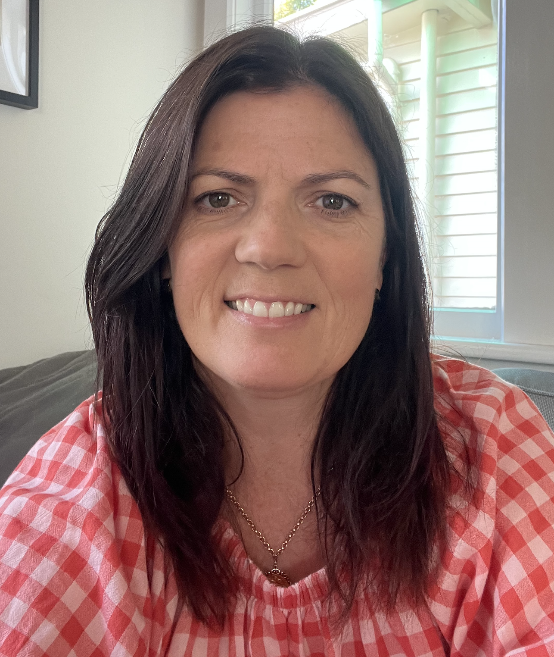
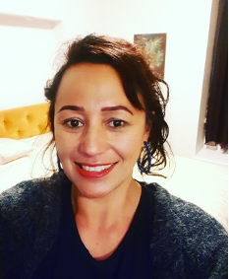
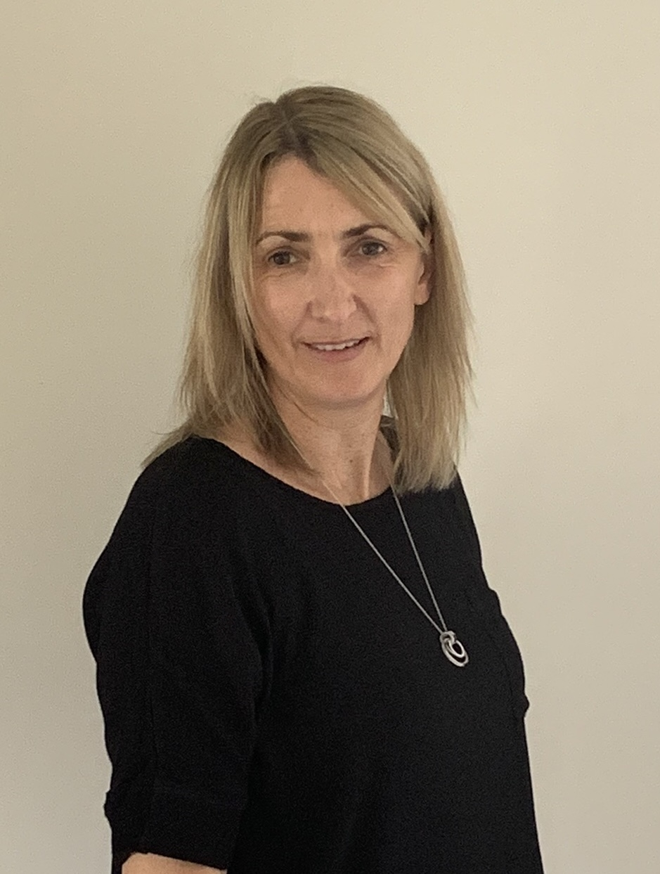
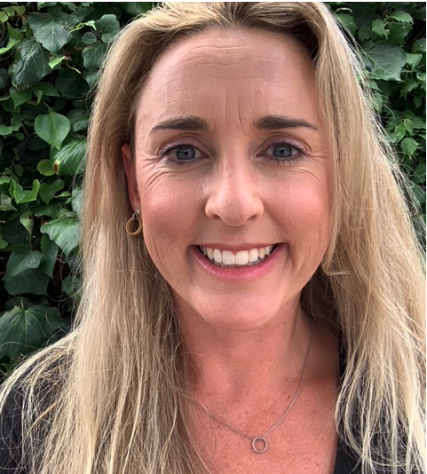

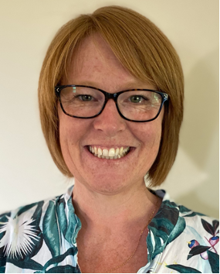
KAIHĀPAI
Kaihāpai : Maria Dacre
Kaihāpai : Jasmine Hansen
Kaihāpai : Danielle Hodson
Kaihāpai : Karen Mackay
2nd year part time students
Papaioea - Manawatu
Whanganui & Ngåmotu
Te Matau-a-Māui – Hawkes Bay
Kaihāpai : Melinda Dixon
Kaihāpai : Louise Fitzgerald
Kaihāpai : Philippa Isom
Tamaki Makaurau – Auckland
1st year Part time students
Te Tai Tokerau - Northland

Slide 15
KAIAKO HĀPAI - ASSOCIATE TEACHER ROLE
ROLES AND RESPONSIBILITIES
We can take a quick look at pg 16 onwards of the Practicum Handbook
Focus Areas:
Induction of Kaiako Pitomata – expectations
Attendance
If you have concerns

Slide 16
Reflective Questions for you to consider…..
Why do you want to be a kaihāpai?
What are your strengths?
What skills and experiences do you bring to the role?
What do you hope to gain from mentoring?

Slide 17
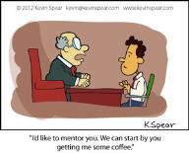
Origins of ‘Mentor’
Mentoring is a process that aims to improve performance and focus on ‘here and now’ rather than on the distance future or past.
Unlocking persons potential to maximise their professional and personal development.

Slide 18
The role of mentoring
Mentoring is different to coaching, supervising and counselling.
Similar to teaching, effective mentoring is starts with the development of a positive relationship.
It involves a shared journey of collaboration and communication
KEY ATTRIBUTES
Trust
Guidance
Empathy/Empathic
listening
Relationship
Goal-oriented
Meaningful feedback
Time investment
Clear boundaries
Interpersonal qualities
Notes:
Attributes needed or sought

Slide 19
How does being a kaiako hāpai benefit your own practice?
Supports and encourages ongoing inquiry into your own teaching practice and other aspects of your professional work
Develops skills and understanding of the job role
Empowers you to feel confident and competent in your personal and professional life
Enhances your skills and qualities as a teacher which in turn influence positive student learning experiences and outcomes
Encourages you to be critically reflective
Provides a space for the sharing of experience and expertise.
(Adapted from Ako Aoteroa Mentoring in Education)

Slide 20

FOSTERS REFLECTION – REFLECTIVE PRACTICE
Besides advising, encouraging, and inspiring, the mentor’s most important role is to foster the mentee’s reflection (on their thoughts and actions). Reflection is an essential process for continual growth as a person and as a professional.
Crasborn, Hennissen, Brouwer, Korthagen & Bergen (2008).
https://sites.google.com/view/arshaignatius/1a/learning-focused-culture?authuser=0
Kaiako pitomata are asked to critically reflect on their practice each day focusing on their professional goals which align with the Teaching Standards.

Slide 21
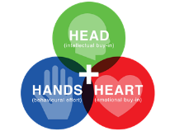
Triple H approach
Successful mentoring focuses on three elements:
Heart – personal relationships, passion for learning and learners
Head – educational processes, deepening knowledge
Hand – reform – practical implementation at personal, team, organisational levels
Notes:
Connecting with your student and forming a positive trusting relationship, sharing knowledge, skills and expertise, supporting them to learn the systems and processes at your school.

Slide 22
Heart –emotional connection
Heart | Head | Hand
Be aware of emotions Relationship - connect Share your values & beliefs Energy and Passion for the role Be inspirational | Content knowledge Pedagogical approaches Curriculum knowledge Student and community knowledge Assessment | support, affirm expose them to career opportunities protect and challenge them Believe in the ability/capacity of mentee Inspire – possibilities, opportunities Instrumental – networking and making contacts Role model for them

Slide 23
SUMMARY OF EFFECTIVE MENTORING
Heart
Provide emotional and psychosocial support
Head
Support construction of personal, practical knowledge about teaching
Structure mentoring conversations to foster reflection, build strategies and ongoing growth
Hands
Create favourable context for learning and teaching Change behaviour – grow a competent and confident professional

Slide 24
Deliberate Acts of mentoring
Dispositions | Skills | Knowledge
Approachable - positive Confident in own practice and abilities Open to new ideas; to differences Passionate about teaching Reflective Fair, reliable and reasonable Realistic and flexible Generous Responsive to need and new ideas of the kaiako pitomata Tactful/diplomatic View mentees as teachers and learners Credible and having integrity Balancing encouragement and criticism Willing to work in partnership at school and with Massey University Allowing kaiako pitomata to bring their identity into their teaching Views learning in its broader sense – not just a checklist | Building confidence and self belief Encouraging agency Building trusting and respectful relationships Able to lead a difficult conversation Modelling exemplary teaching and management Co-teaching with conversations in the moment Giving space to try new things Providing honest and timely feedback/next steps Critical questioning that prompts reflection Seizing a mentoring moment Pushing further – moving on from baby steps Being able to break down complexity Able to unpack success or failure Observing with follow up conversation Able to connect teaching decisions to impact on learners Conveys clear expectations Supporting the emotional experiences of teaching Carving out time for regular support Retaining confidence in the face of challenge | Knowledge of the kaiako pitomata Self knowledge Institutional (school) knowledge Knowledge of school culture Subject content knowledge Pedagogical content knowledge Knowledge of school processes and systems Giving access to the school’s physical resources Knowledge of teaching as inquiry Knowledge of assessment tools …and making all this knowledge available

Slide 25

Kaihāpai key take homes
Shoulder to shoulder approach
Guide alongside strategy
Relationship is important
Communication is pivotal

Slide 26
PRACTICUM TASKS
TASKS
The three main tasks for attention while on practicum 1A:
1. Professional Learning Goals
Professional relationships
Learning focused culture
2. Familiarisation with Setting
Using data to inform decisions. This task will require support.
3. Design for Learning
- Observation, Planning, Teaching, Assessing including formal observations of their teaching by ATs.

Slide 27
PRACTICUM TASKS
Kaiako pitomata are also be required to:
collate evidence of progress for each of the Teaching Standards appropriate to their stage of study/practice
In addition to the practicum placements KP will also :
Complete 5 days/25 hours of Focussed Placement
8 microteaching sessions (2 literacy, 2 math, 2 science, 2 arts)

Slide 28
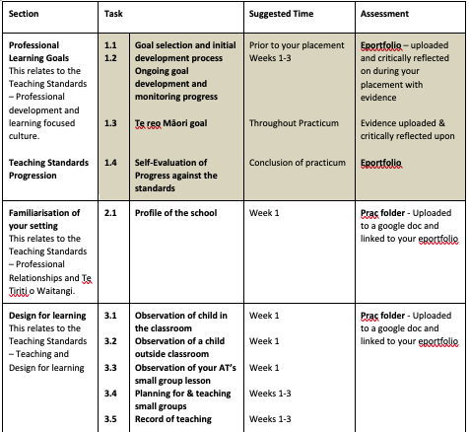
PRACTICUM 1A TASKS

Slide 29
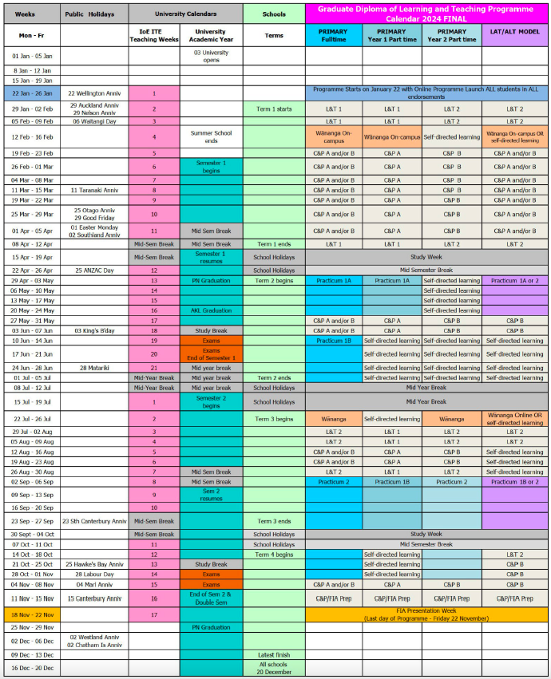
PROFESSIONAL PRACTICE TIMING)

Slide 30
PRACTICUM 1A APPRAISAL
The first appraisal will likely be online rather than a face-to-face visit followed by a face to face observation and appraisal in 1B.
This is hoped where possible to be a triadic discussion with the kaiako pitomata (student), the kaiako hāpai (AT) and the appraiser (in most cases this will be the kaihāpai/group mentor).

Slide 31
If there are concerns with a Kaiako Pitomata
Lead mentors and ATs should be proactive about requesting a conversation at that time if you have any concerns.
You as the AT are not responsible for passing or failing a student – we take a holistic view of practicum that determines outcomes and considers a range of evidence. This process is thorough and taken very seriously.
Data is triangulated including the appraiser report, the practicum progress report and the submission of evidence in the digital portfolio. This assessment process is moderated and if there are concerns that a student has not met the LO’s then a panel review takes place with leadership. It is a robust process and carefully considered.

Slide 32
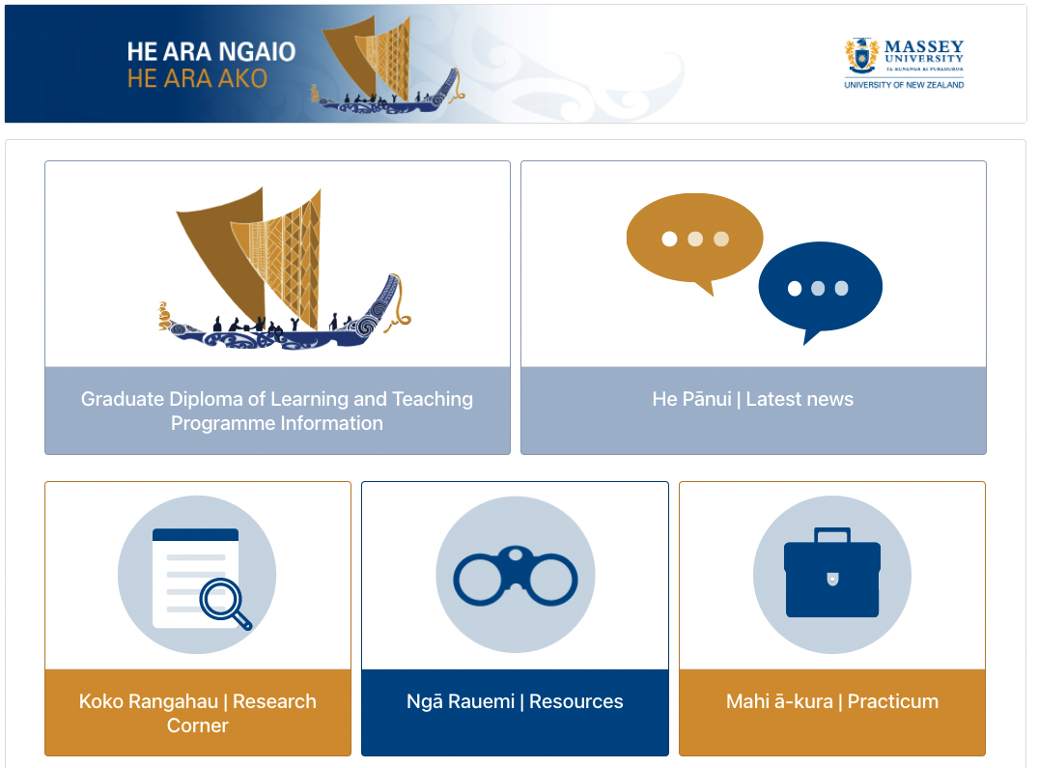
He ara ngaio, he ara ako
https://masseyite.lms.net.nz/
This website has been developed to support you as kaiako håpai and to provide information relating to the programme and course content.

Slide 33
Patai? questions?
Do you have any further questions?

Slide 34
GOING FORWARD
MY QUESTION: What would be helpful for you as AT going forward? You don’t have to answer that now – please give it some thought and feel free to email me if you have suggestions.
J.Hansen1@massey.ac.nz

Slide 35
CLOSING KARAKIA
Unuhia, unuhia
Unuhia ki te uru tapu nui
Kia wātea, kia māmā, te ngākau, te tinana, te wairua i te ara takatā
Koia rā e Rongo, whakairia ake ki runga
Kia tina! TINA! Hui e! TĀIKI E!
Kia kaha, kia maia, kia manawanui!

